Slide 1
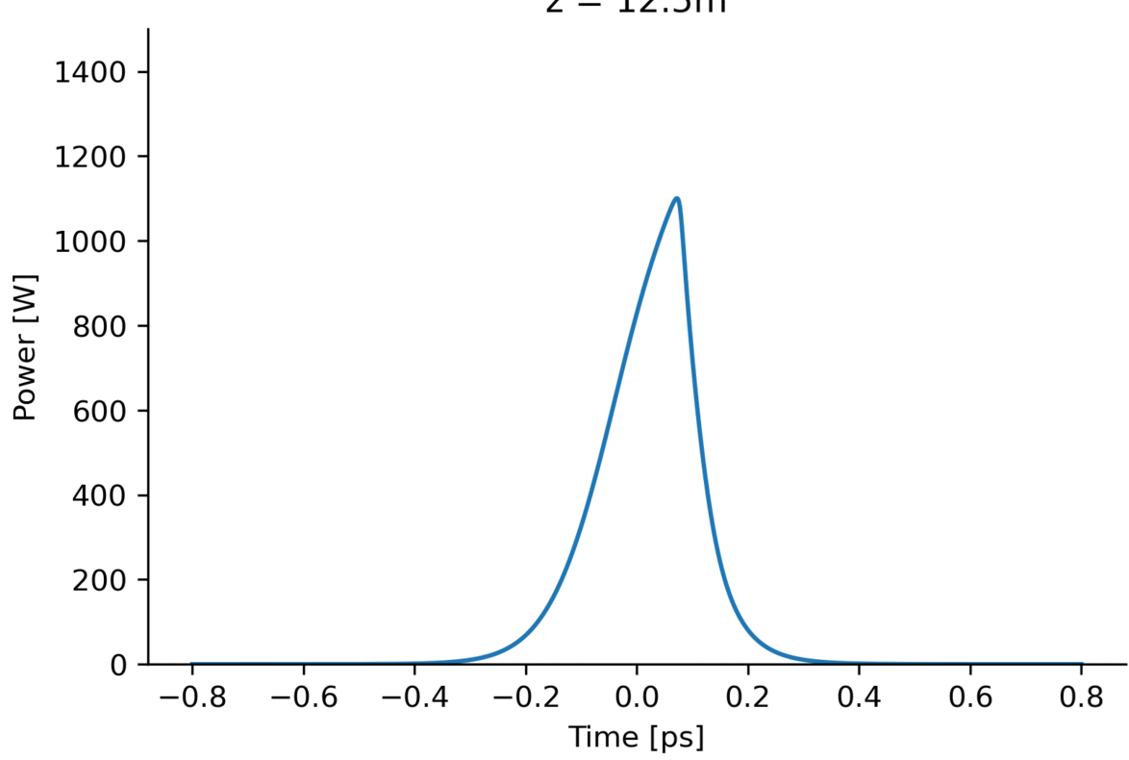
Self-
steepening

Slide 2
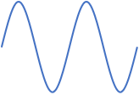
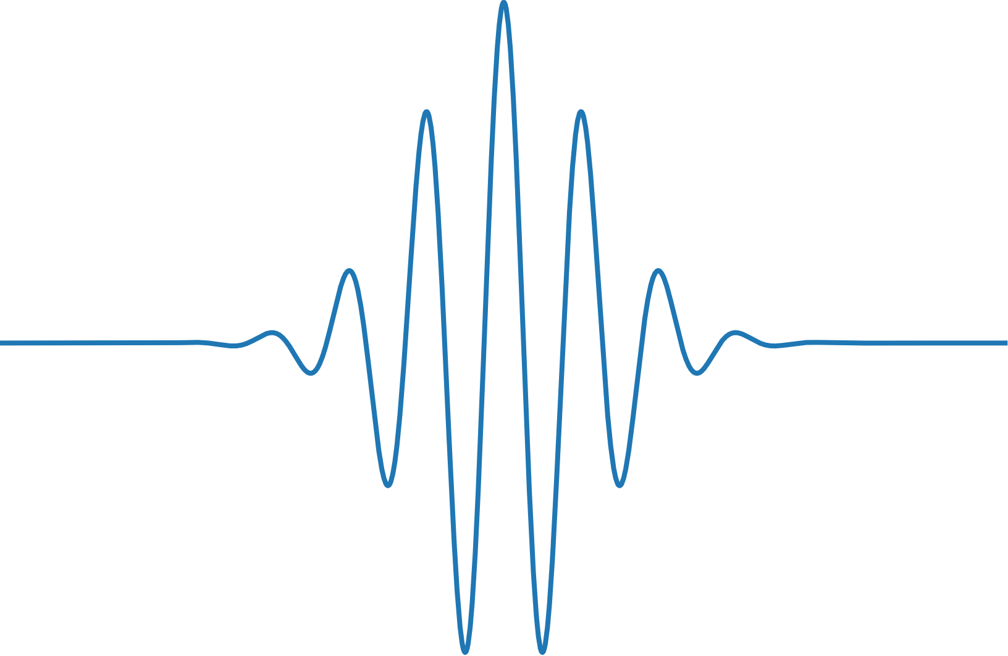
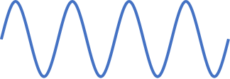
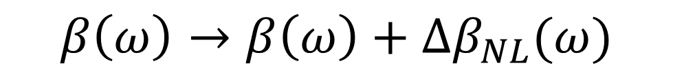
Change in spatial frequency
$$β\left(ω\right)=n\left(ω\right)ωc^{−1}=β_{0}+β_{1}\left(ω−ω_{0}\right)+\frac{1}{2}β_{2}{\left(ω−ω_{0}\right)}^{2}+…$$
$$β\left(ω\right)→β\left(ω\right)+Δβ_{NL}(ω)$$
Change in spatial frequency due to NL effects
$$Δβ_{NL}\left(ω\right)=Δβ_{0}+Δβ_{1}\left(ω−ω_{0}\right)+\frac{1}{2}Δβ_{2}{\left(ω−ω_{0}\right)}^{2}+…$$

Slide 3
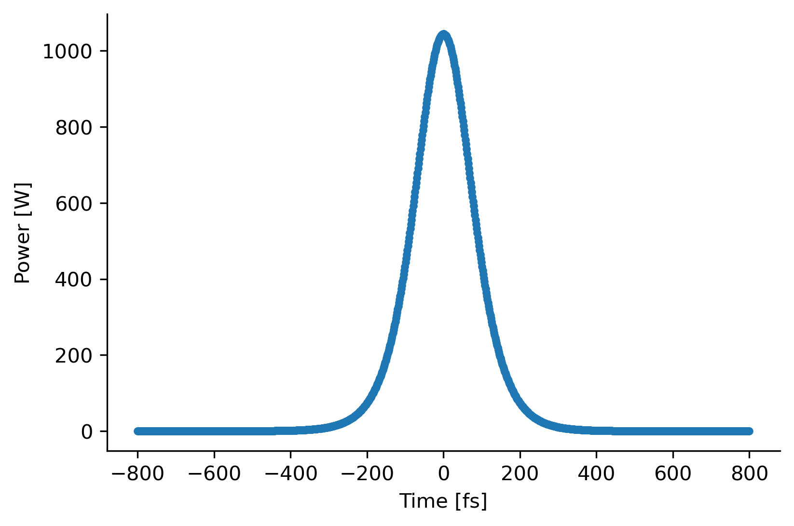

Simple nonlinear phase shift
$$\exp\left(\hat{N}Δz\right)=\exp\left(iγ{\left|A\right|}^{2}Δz\right)$$
“Phase shift proportional to power.”
Same power = Same phase shift!

Slide 4
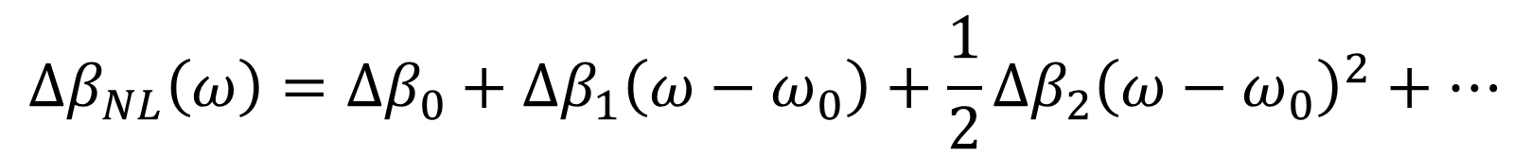
Change in spatial frequency
$$β\left(ω\right)=n\left(ω\right)ωc^{−1}=β_{0}+β_{1}\left(ω−ω_{0}\right)+\frac{1}{2}β_{2}{\left(ω−ω_{0}\right)}^{2}+…$$
$$β\left(ω\right)→β\left(ω\right)+Δβ_{NL}(ω)$$
Change in spatial frequency due to NL effects
$$Δβ_{NL}\left(ω\right)=Δβ_{0}+Δβ_{1}\left(ω−ω_{0}\right)+\frac{1}{2}Δβ_{2}{\left(ω−ω_{0}\right)}^{2}+…$$

Slide 5
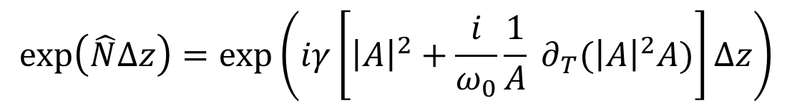

More accurate nonlinear phase shift
$$\exp\left(\hat{N}Δz\right)=\exp\left(iγ\left[{\left|A\right|}^{2}+\frac{i}{ω_{0}}\frac{1}{A} ∂_{T}({\left|A\right|}^{2}A)\right]Δz\right)$$
“Phase shift depends on gradient”
High change in $n$ means high change in speed!
Opposite slopes = Opposite phase shifts!

Slide 6
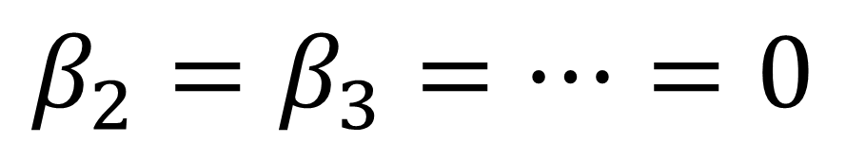
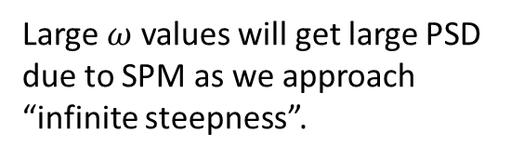
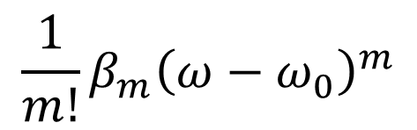
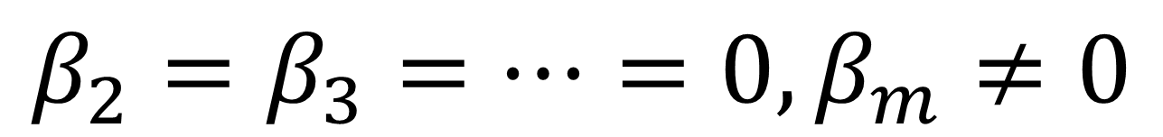
Result: Self-Steepening!
See link in description for more details!!!
$$β_{2}=β_{3}=…=0,β_{m}≠0$$
$$β_{2}=β_{3}=…=0$$
$$\frac{1}{m!}β_{m}{\left(ω−ω_{0}\right)}^{m}$$
Large $ω$ values will get large PSD due to SPM as we approach “infinite steepness”.
Thus, temporal broadening smoothen pulse before infinite steepness is achieved

